Slide 1
Material and Fastener Data Retrieval Add-Ins Presenter: Bindi Nagda, Aerospace Engineering

Slide 2
Purpose
To gather accurate, approved Material and Fastener Data for aerospace applications into a single location that can then be retrieved quickly through the use of easily installable add-ins.
This would produce a more standardized method for design of aerospace parts across multi-disciplined teams and eliminate huge amounts of time collecting and ensuring the data is accurate.

Slide 3
Introduction
Aerospace Engineers frequently read various Materials and Fasteners Specs during the design process
Specifications must conform to approved government standards, e.g. only FAA approved specs can be used when designing an aircraft
The standards have evolved over time. Some Fastener Specs that were defined by Air Corps and the NAF (Naval Aircraft Factory)* have been consolidated to:
AN – Air Force/Navy
NAS – National Aerospace Standards
MS – Military Standards
*However, older specifications are still applicable in some cases where new data hasn’t been published yet.

Slide 4
Introduction
Similarly, Material Specifications have also evolved over time
From MIL-HBDK (Military Handbook) to MMPDS, ASTM, SAE etc.
These spec handbooks must be used simultaneously when designing a large assembly with many metallic components
The handbooks also refer to procurement specs that must be adhered to for each material
Finding a certain design allowable becomes increasingly difficult for each metallic component due to variation in sheet thickness, heat treatment, type of alloy, hardness of the material, testing basis (i.e. A, B or S basis) etc.
Similarly, finding sizing data for various fasteners becomes complicated depending on type of fastener, head style, nominal diameters, shear strengths, material designation etc.

Slide 5
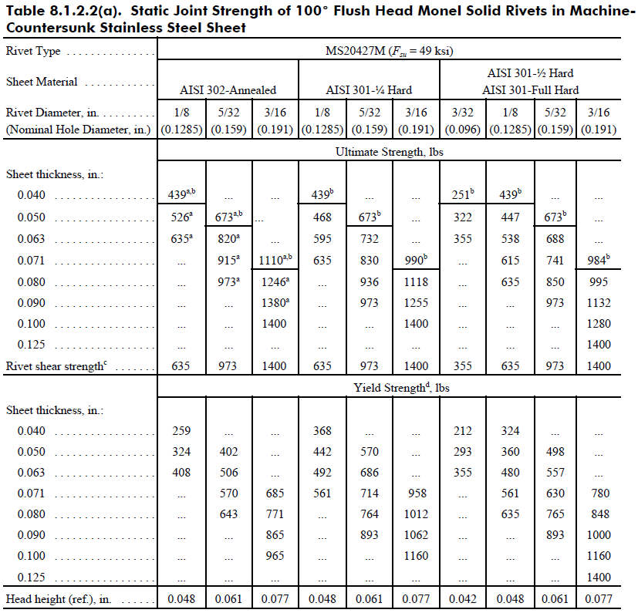

Slide 6
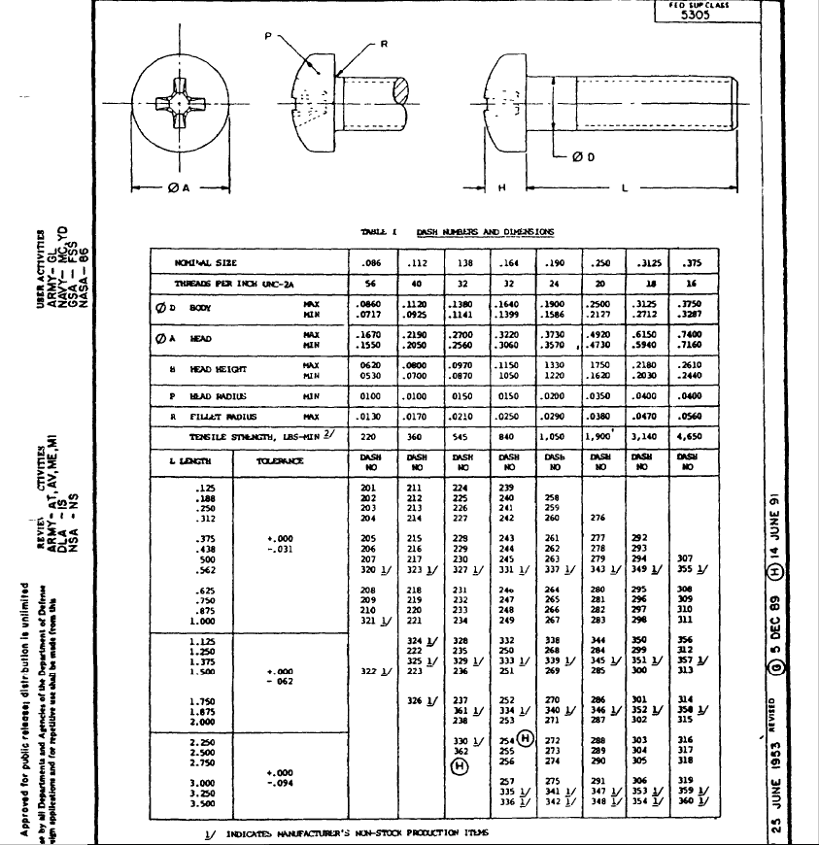

Slide 7
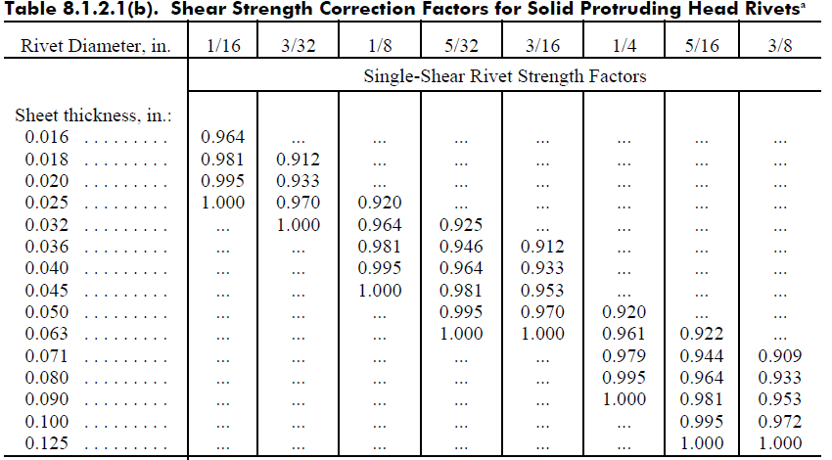

Slide 8
Types of Fasteners
Examples of typical standardized fasteners include:
Bolts
Nuts
Washers
Turnbuckles
Cotter pins
Screws
Rivets
Plumbing fittings (pipes and tubes)

Slide 9
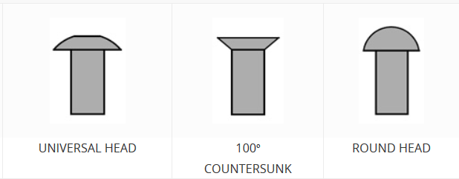
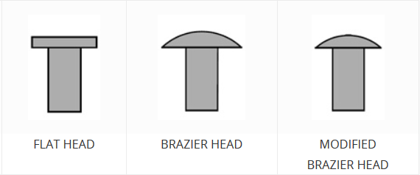
Fasteners Head Styles

Slide 10
Fastener Coding - Rivets
A standard universal head solid rivet manufactured from 2117-T4 aluminum, 1/8 inch diameter and 5/16 inch in length would be coded either AN470AD4-5 or MS20470AD4-5.
AN = manufactured to Air Force/Navy specs
470 = universal type rivet
AD = 2117-T4 Aluminum
(Other designations include: A=1100, B=5056, C=copper, D=2017, DD=2024 Aluminum, F=stainless steel and M=Monel)
Dash Number: 4 = 4/32, or 1/8 inch rivet diameter
-5 = 5/16 inch rivet length

Slide 11
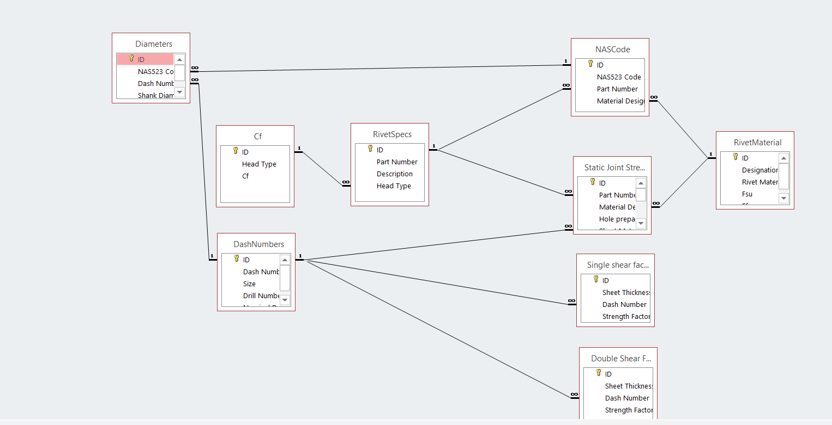
Rivets Database

Slide 12
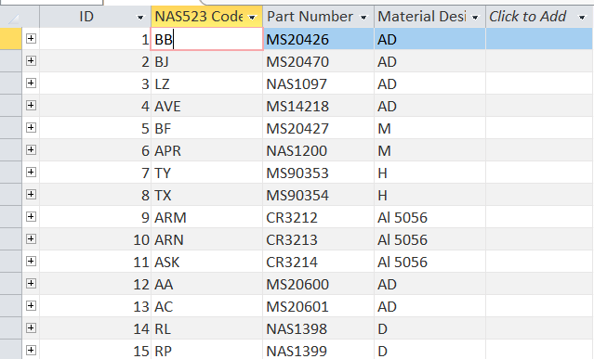
Rivets Database The NAS523 code is the primary means of identifying fasteners made from different materials

Slide 13
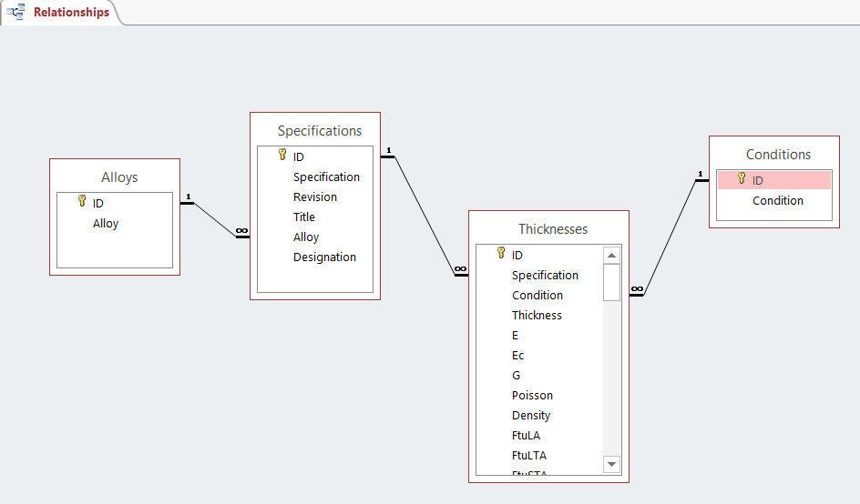
Metallic Materials Properties

Slide 14
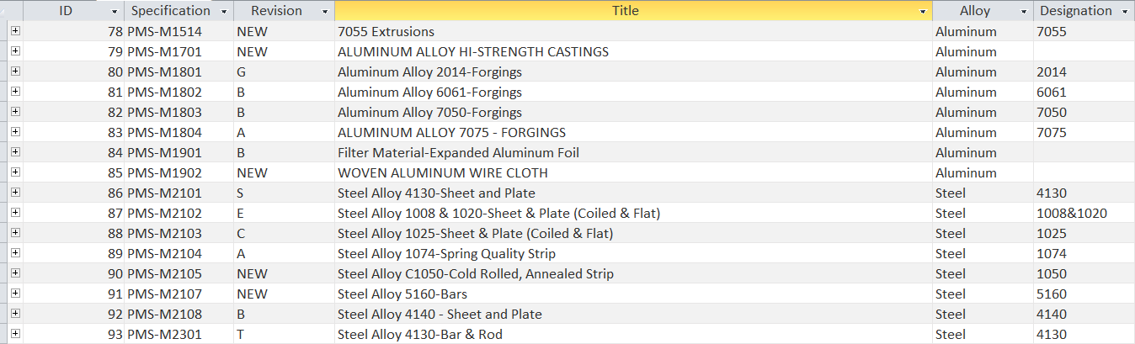

Slide 15
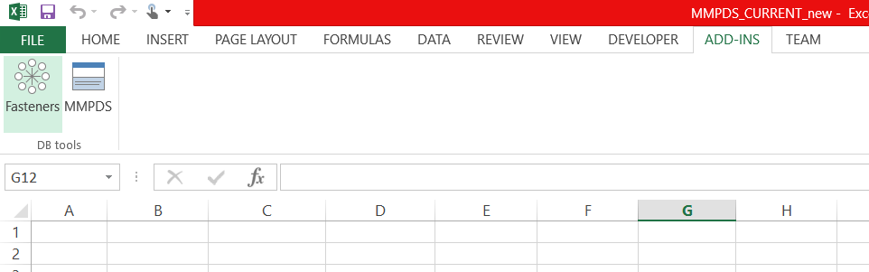
Solution
Two simple-to-use Add-Ins to allow Aerospace design engineers to quickly sift through and retrieve specific sets of Material and Fastener data, improving accuracy and reducing huge amounts of time when collecting design allowables.

Slide 16
Solution
Some basic steps are required in order to be able to access and manipulate data using ADO (ActiveXDataObjects):
Create a connection object to connect to the database via OLE DB. OLE DB (Object Linking and Embedding, Database) is an API designed by Microsoft that allows accessing data from a variety of sources in a uniform manner.
ADO provides a middle layer between programming languages and OLE DB. ADO allows a developer to write programs that access data without knowing how the database is implemented
Create a recordset object in order to receive data in.
Open the connection

Slide 17
Populate the recordset by opening it and passing the desired table name or SQL statement as a parameter to the “open” function.
Do all the desired searching/processing on the fetched data.
Commit the changes you made to the data by using Update methods.
Print out the data recorded onto a specified range in the worksheet and format the layout as necessary
Close the recordset
Close the connection

Slide 18
Further Research
Write API’s to automate the process of populating the material cards and property cards in CAD softwares like SolidWorks, or Finite Element Analysis softwares like ANSYS and FEMAP.
This would be done in the same way by searching through the relevant database and filling in the right properties into the cards before designing a part
Expand the database and improve the add-in to include composite material allowables.

Slide 19
THANK YOU

